Slide 1
Chapter 17
Change of Phase

Slide 2
This lecture will help you understand:
Phases of Matter
Evaporation
Condensation
Boiling
Melting and Freezing
Energy and Changes of Phase

Slide 3
Phases of Matter
Matter exists in four common phases that involve transfer of internal energy:
  Solid phase (ice)
  Liquid phase (ice melts to water)
  Gaseous phase (water turns to vapor; addition of more energy vaporizes water to vapor)
  Plasma phase (vapor disintegrates to ions and electrons)

Slide 4
Phases of Matter
The phase of material depends upon the temperature and pressure.
Change from Solid → Liquid → Gas → Plasma requires energy to be added to the material.
Energy causes the molecules to move more rapidly.

Slide 5
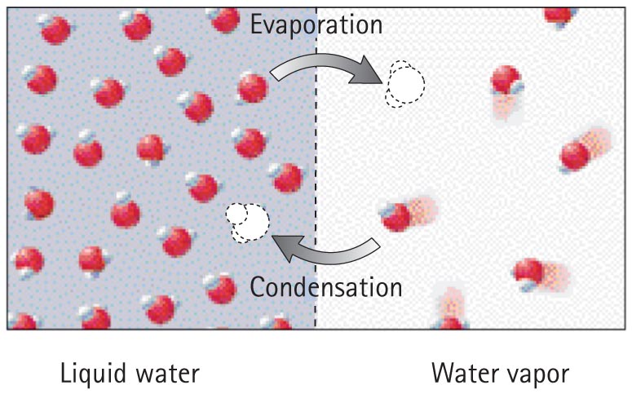
Evaporation
Evaporation
Change of phase from liquid to gas

Slide 6

Evaporation
Molecules in liquid move randomly at various speeds, continually colliding into one another.
Some molecules gain kinetic energy while others lose kinetic energy during collision.
Some energetic molecules escape from the liquid and become gas.
Average kinetic energy of the remaining molecules in the liquid decreases, resulting in cooler water.
→ evaporation is a cooling process.

Slide 7
Evaporation
Evaporation is important in cooling our bodies when we overheat
  Sweat glands produce perspiration.
  Water on our skin absorbs body heat as evaporation cools the body.
  Helps to maintain a stable body temperature.

Slide 8
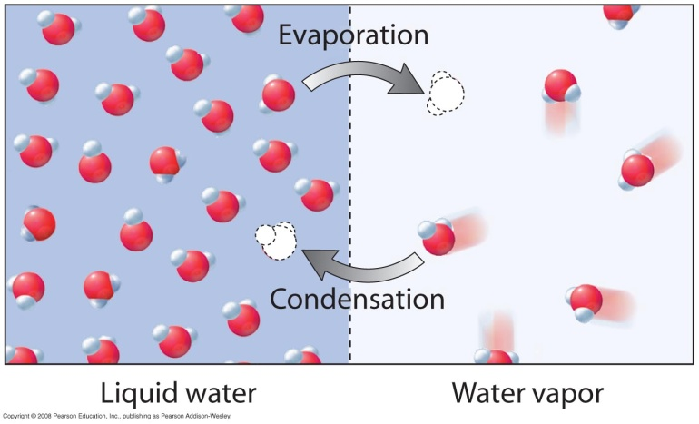
Condensation
Condensation process
Opposite of evaporation
Warming process from a gas to a liquid
Gas molecules near a liquid surface are attracted to the liquid
They strike the surface with increased kinetic energy, becoming part of the liquid

Slide 9

Condensation
Kinetic energy is absorbed by the liquid, resulting in increased temperature.
Examples:
  Steam releases much energy when it condenses to a liquid and moistens the skin—hence, it produces a more damaging burn than from same-temperature 100°C boiling water.
  You feel warmer in a moist shower stall because the rate of condensation exceeds the rate of evaporation.

Slide 10

Condensation
Examples:
  In dry cities, the rate of evaporation from your skin is greater than the rate of condensation, so you feel colder.
  In humid cities, the rate of evaporation from your skin is less than the rate of condensation, so you feel warmer.
  A cold soda pop can is wet in warm air because slow-moving molecules make contact with the cold surface and condense.

Slide 11
Condensation in the Atmosphere
The measure of the amount of water vapor in the air is humidity or mass of water per volume of air.
Relative humidity is the ratio of the present humidity to the greatest humidity or amount of water the air could hold at that temperature.
Saturation occurs when air temperature drops and water vapor begins condensing.

Slide 12
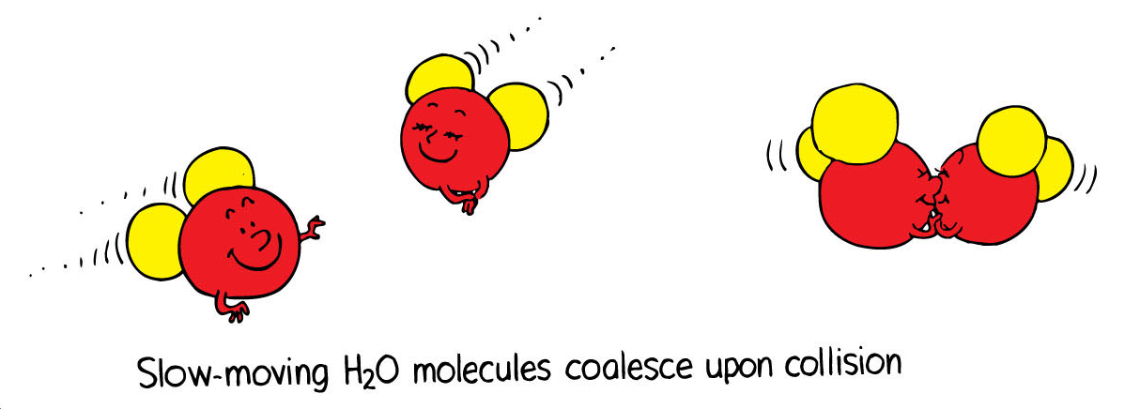
Condensation
Condensation in the atmosphere
When the temperature of the atmosphere is low, the water molecules in the air move slowly.
Slow-moving water molecules stick together, causing condensation.
Example: Fog and clouds created when air rises

Slide 13
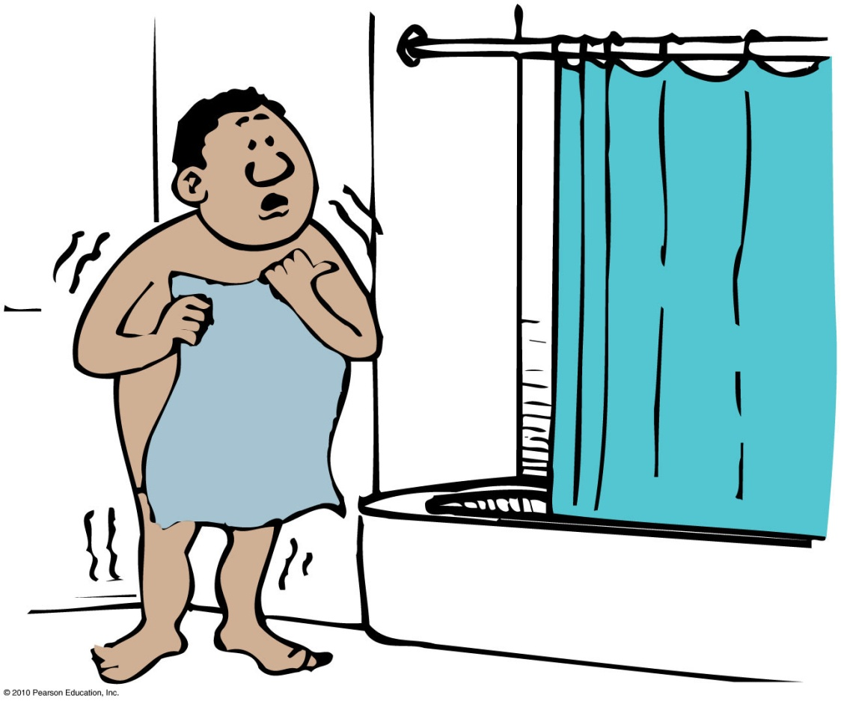
When you step out after a hot shower you feel cold, but you can feel warm again if you step back into the shower area. Which process is responsible for this?
Evaporation
Condensation
Both of these.
None of the above.

Slide 14
When you step out after a hot shower you feel cold, but you can feel warm again if you step back into the shower area. Which process is responsible for this?
Evaporation
Condensation
Both of these.
None of the above.
Explanation:
When you step back into the shower area, the steam that is present condenses on your body, causing it to warm up.

Slide 15
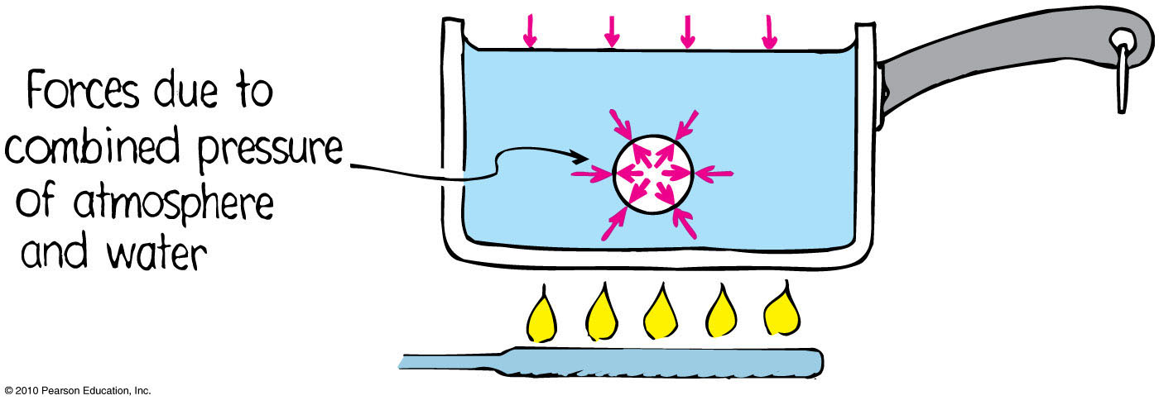
Boiling
Boiling process
Rapid evaporation from beneath the surface of a liquid.

Slide 16
Boiling
Boiling process
Rapid form of evaporation beneath the surface forms vapor bubbles.
Bubbles rise to the surface.
If vapor pressure in the bubble is less than the surrounding pressure, then the bubbles collapse.
Hence, bubbles don’t form at temperatures below boiling point (vapor pressure is insufficient).

Slide 17
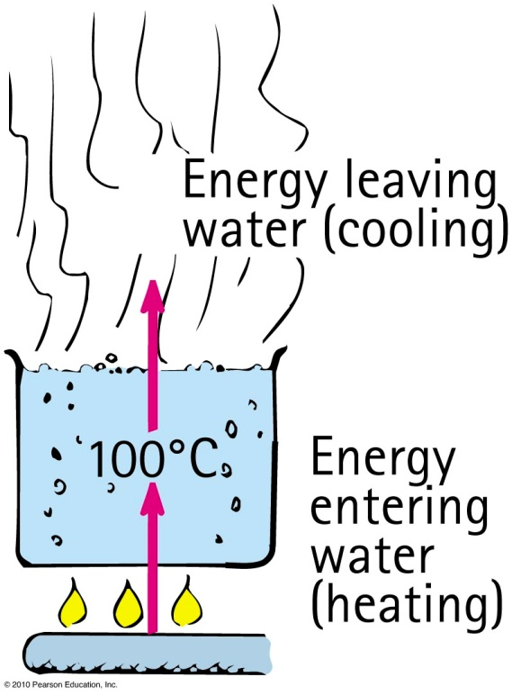
Boiling
Boiling process
Boiling water at 100°C is in thermal equilibrium—boiling water is being cooled as fast as it is being warmed.
In this sense, boiling is a cooling process.

Slide 18
Boiling
Boiling point depends on pressure.
  Example: Buildup of vapor pressure inside a pressure cooker prevents boiling, thus resulting in a higher temperature that cooks the food.
Boiling point is lower with lower atmospheric pressure.
Example: Water boils at 95°C in Denver, CO (high altitude) instead of at 100°C (sea level).

Slide 19
The process of boiling
A. cools the water being boiled.
depends on atmospheric pressure.
is a change of phase below the water surface.
All of the above.
Notes:
D. all of these.

Slide 20
The process of boiling
A. cools the water being boiled.
depends on atmospheric pressure.
is a change of phase below the water surface.
All of the above.
Notes:
D. all of these.

Slide 21
Melting and Freezing
Melting
Occurs when a substance changes phase from a solid to a liquid
Opposite of freezing
When heat is supplied to a solid, added vibration breaks molecules loose from the structure and melting occurs.

Slide 22
Melting and Freezing
Freezing
Occurs when a liquid changes to a solid
Opposite of melting
When energy is continually removed from a liquid, molecular motion decreases until the forces of attraction bind them together and formation of ice occurs.

Slide 23
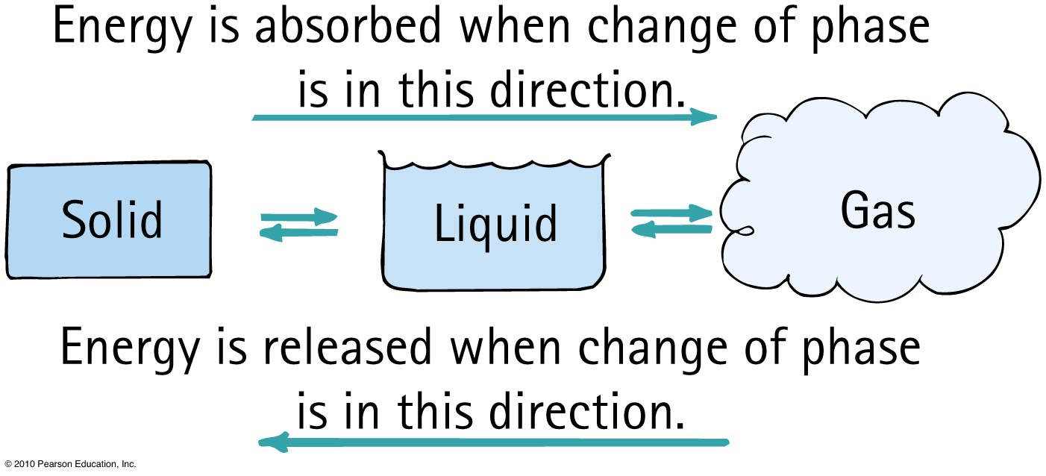
Energy and Change of Phase
Energy and Change of Phase
From solid to liquid to gas phase
  add energy
From gas to liquid to solid phase
  remove energy

Slide 24
Energy and Change of Phase
Heat of fusion
Amount of energy needed to change any substance from solid to liquid and vice versa
  Heat of fusion for water is 334 joules/g.

Slide 25
Energy and Change of Phase
Heat of vaporization
Amount of energy needed to change any substance from liquid to gas and vice versa
  Heat of vaporization for water is 2256 joules/g.

Slide 26
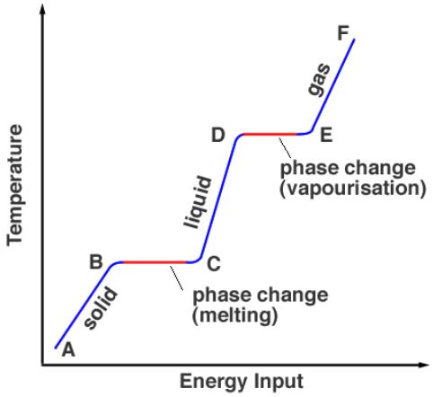
http://www.splung.com/content/sid/6/page/latentheat

Slide 27
When snow forms in clouds, the surrounding air is
A. cooled.
warmed.
insulated.
thermally conducting.
Hint: the change of phase is from gas to solid.
Notes:
B. warmed.

Slide 28
When snow forms in clouds, the surrounding air is
A. cooled.
warmed.
insulated.
thermally conducting.
Explanation:
The change of phase is from gas to solid, which releases energy.
Notes:
B. warmed.

Slide 29
Ice is put in a picnic cooler. To speed up the cooling of cans of beverage, it is important that the ice
A. melts.
is prevented from melting.
be in large chunks.
None of the above.
Notes:
A. melts.

Slide 30
Ice is put in a picnic cooler. To speed up the cooling of cans of beverage, it is important that the ice
A. melts.
is prevented from melting.
be in large chunks.
None of the above.
Explanation:
For each gram of ice that melts, 540 calories is taken from the beverage.
Notes:
A. melts.

Slide 31
Homework
Exercises 1, 3, 11, 15, 23, 31, 41, 49, 55, 57
Due: July 11

